Slide 1

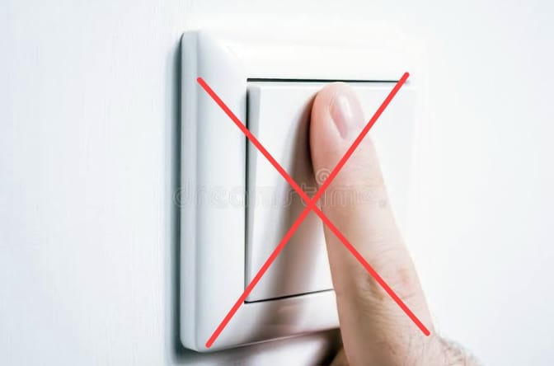
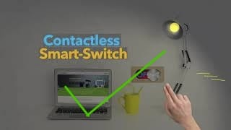
GEETHANJALI INSTITUTE OF SCIENCE AND TECHNOLOGY Gangavaram(V),Kovur(M),Nellore(Dt),AndhraPradesh,India-524137 Accredited with NAAC A , Affiliated to JNTU Anantapur
Department of Electronics and Communication Engineering
Contactless Smart Switch
For COVID isolation centres
Presented By :
Sk.Asif – 192U1A04D9
SK.Khaja Mohiddin – 192U1A04E3
Sk.Mohammad Javad – 192U1A04E5
Sk.Mohammad Taj – 192U1A04E6

Slide 2
Contents
Introduction
Requirements
Circuit diagram
Working
Applications
conclusion

Slide 3
INTRODUCTION
To stay from the danger of contracting coronavirus, it is significant not to contact surfaces including switches, door handles that have been as often as possible Utilized by others.
This undertaking is for a contactless switch that works with hand signals, that can identify hand developments and make an interpretation of them into orders for controlling electrical appliances such as lights, fans, etc.,

Slide 4
REQUIREMENTS
Hardware requirements:
Arduino uno
IR Obstacle Sensor module
5 Volt Relay
Jumper wires
Holder
Electric wires
Software requirements
Arduino Ide

Slide 5
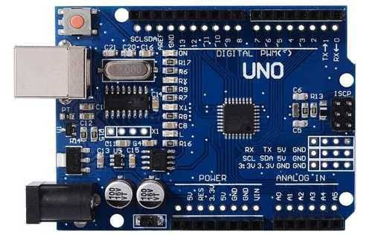
HARDWARE COMPONENTS
Arduino uno :
Arduino is an open-source electronics platform based on easy-to-use hardware and software. Arduino boards are able to read inputs – light on a sensor, a finger on a button, or a Twitter message – and turn it into an output – activating a motor, turning on an LED, publishing something online.

Slide 6
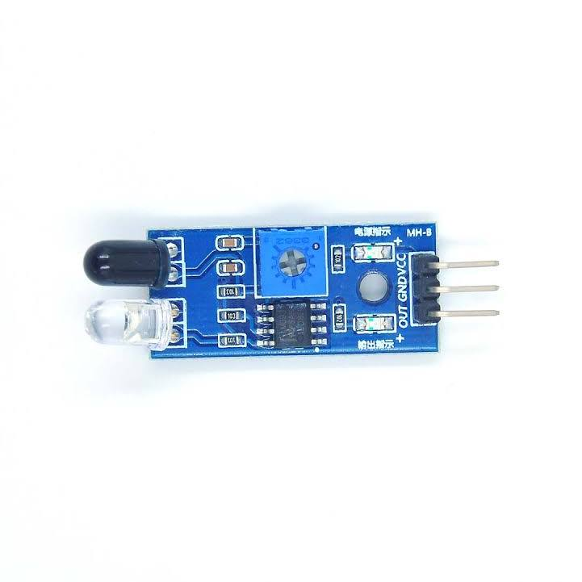
IR Obstacle sensor : The Infrared Obstacle Avoidance Sensor has a pair of infrared transmitting and receiving sensors. The infrared LED emits Infrared signals at certain frequency and when an obstacle appears on the line of infrared light, it is reflected back by the obstacle which is sensed by the receiver.

Slide 7
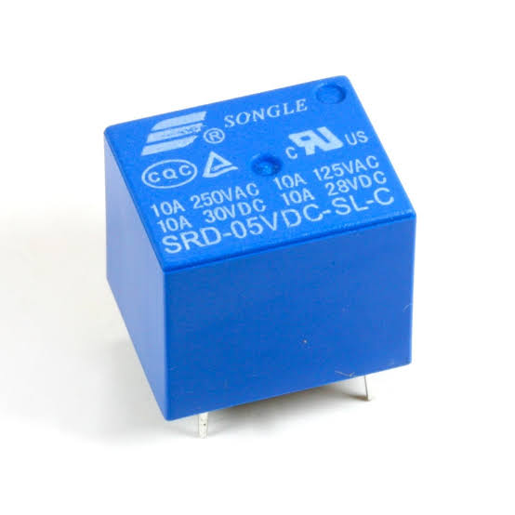
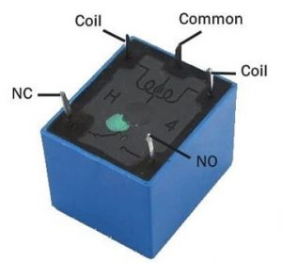
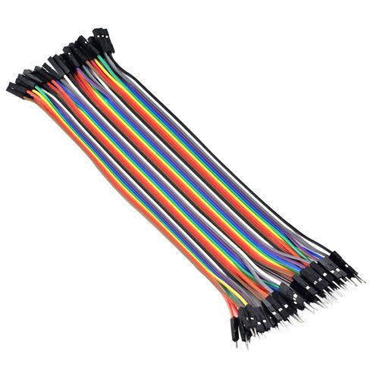
5 volt Relay :
A 5v relay is an automatic switch that is commonly used in an automatic control circuit and to control a high-current using a low-current signal. The input voltage of the relay signal ranges from 0 to 5V.
Jumper wires :
Jumper wires are used to connect two points in a circuit. All Electronics stocks jumper wire in a variety of lengths and assortments

Slide 8
SOURCE CODE
#define r1 13 int relay1 = LOW; int obstaclePin = 7; // This is our input pin int hasObstacle = HIGH; void setup() { pinMode(r1, OUTPUT); pinMode(obstaclePin, INPUT); Serial.begin(9600); } void loop() { hasObstacle = digitalRead(obstaclePin); if (hasObstacle == LOW) { relay1 = ~ relay1; digitalWrite(r1,relay1); delay(1000); }

Slide 9
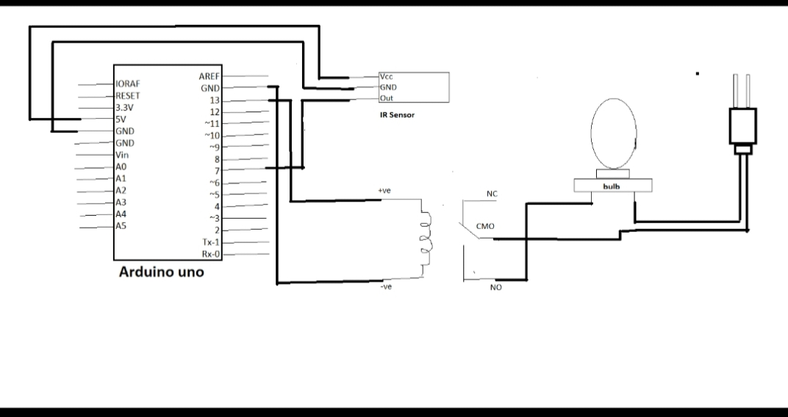
CIRCUIT DIAGRAM

Slide 10
WORKING
In the above diagram, we can see that the positive and negative pins of the 5v Relay connected to the arduino. The positive pin is connected to pin13 and the negative pin is connected to the GND pin of the Arduino with the help of jumper wires
The ouput of the IR Obstacle sensor is connected to the pin 7 of the arduino , like that the Vcc of IR sensor is connected to the 5volt Pin of arduino, and the output of IR sensor is also connected to the output of the arduino board.
Now the electrical wires are connected to the COM pin of the 5v Relay and power source is also connected .
ThIs Results in the proper working of the conctactless smart switch .

Slide 11
APPLICATIONS
Covid isolation centres
Homes, offices, industries etc.
Biological laboratories
Chemical plants
Pharmaceutical industries
Public transport corridors like bustands, railway stations, aiports etc.

Slide 12
Conclusion
Social distancing is one of the best methods to escape from covid -19 . But it is not applicable for all cases . In some chumaisolation centres, covid patients may use the same switches to switch on/off the Fans, lights etc. In this case the Spreading of disease is most likely to happen. So we recommend using of these contactless smart switches to avoid spreading of contagious diseases. It Is not only applicable for isolation centres, It is very much appilcable in places that we have mentioned In the above applications, we recommend using of these contactless smart switches which will play a vital role in the future saving humans from the Contagious diseases and will definitely ensure us a healthy life.

Slide 13
REFERENCES
http://www.ijmtst.com/vol7issue06.html
https://youtu.be/b8GVj1tUmGE
https://drive.google.com/file/d/14oOpsI30G4Rt75evLi8RcU_bstLCpesJ/view
Ieee-sensors.org/myosa/rgb-and-gesture-sensor/sharvielectronics.com/product/apds9960-rgb-gesture-sensor-detection-i2c-breakout-module-for-arduino.

Slide 14


